Slide 1
Credit Card Approval: Improving Model with
Diverse Machine Learning Techniques

Slide 2
We are Team of 3!
Raihan Khan, Adnan Vaktapuriya, Jiwan Khabra

Slide 3
Agenda:
1. | Introduction
2. | Problem statement
3. | Related Works
4. | Data
5. | Methodology
6. | Results
7. | Conclusion

Slide 4
Introduction
Credit card fraud poses a major risk to financial institutions and customers.
Detecting fraudulent transactions is challenging due to highly imbalanced data (only 0.17% fraud).
Traditional accuracy metrics fail to capture true performance in such settings.
By applying advanced preprocessing, imbalance handling, and model tuning, we aim to create a system that improves reliability and reduces financial risk.

Slide 5
Problem statement
Credit approval & fraud detection are critical in modern financial systems.
Lenders must assess applications accurately to avoid:
Financial loss
Unfair decisions & bias
Goal: Increase reliability & reduce fraud risk by improving model performance to ~97–98%.

Slide 6
Why this matters
Fraud costs financial institutions billions per year.
Traditional accuracy is misleading due to extreme class imbalance.
Missing a fraud case (false negative) has high cost.
Need a system that:
Detects rare fraud cases
Minimizes false alarms
Works reliably in real-world banking pipelines

Slide 7
Related Works
Fraud detection is widely studied as an imbalanced classification problem.
Prior research highlights challenges such as extreme imbalance, evolving fraud patterns, and real-time detection needs.
Survey papers (Lucas & Jurgovsky, 2020; Dastidar et al., 2024) compare machine learning methods including:
Logistic Regression
Decision Trees
Random Forests
Gradient Boosting
Neural Networks
Studies show tree-based ensemble methods (especially Random Forests) consistently achieve strong performance on imbalanced credit card datasets.
Research also emphasizes using PR-AUC, ROC-AUC, and F1-score instead of raw accuracy for reliable evaluation.

Slide 8
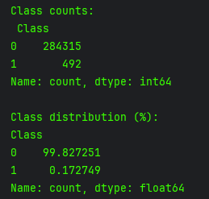
Data
Credit Card Fraud Detection Dataset (Kaggle)
284,807 transaction rows
30 features
PCA-transformed V1–V28
Time, Amount
Fraud cases: 492 (~0.17%)
Highly imbalanced → requires special evaluation & model handling

Slide 9
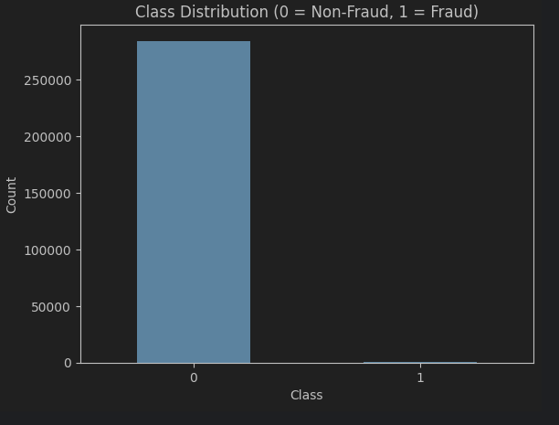

Slide 10
Methodology
To improve performance, we built a complete ML pipeline:
Data Preprocessing
Standardization of Amount
Stratified train/test split
No missing values
Imbalance Handling
Class weighting
SMOTE during training

Slide 11
Methodology cont.
Modeling
Baseline Logistic Regression
Tuned Random Forest
Evaluation
PR-AUC, ROC-AUC, F1 (fraud)
Confusion matrix
Hyperparameter Tuning
3-fold cross-validation
RandomizedSearchCV

Slide 12
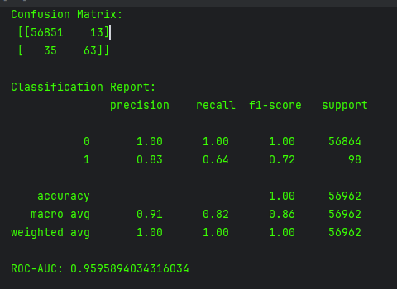
Baseline Model
Logistic Regression
Strong accuracy
Weak recall for fraud class
Motivated use of tree-based methods for non-linear interactions

Slide 13
Random Forest
Why Random Forest?
Handles non-linear patterns
Naturally robust to noise
Works well on imbalanced tabular data
Supports class weighting
Key settings:
n_estimators = 200
max_depth = None
min_samples_split = 5
min_samples_leaf = 1
SMOTE + class_weight = “balanced”

Slide 14
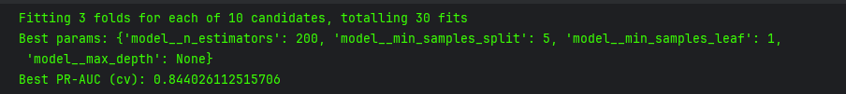
Hyperparameter Tuning
Used GridSearchCV with PR-AUC as scoring metric.
Best parameters:
200 trees
min samples split = 5
leaf = 1
no max depth
Result: Best validation PR-AUC ≈ 0.844

Slide 15
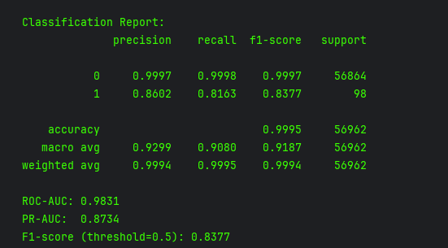
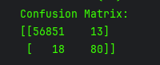
Test Set Results
Final Model Performance:
Accuracy: 99.95%
ROC-AUC: 0.9831
PR-AUC: 0.8734
Fraud F1-score: 0.8377
Fraud Precision: 0.8602
Fraud Recall: 0.8163
These results confirm the model detects most fraud cases while minimizing false positives.
Confusion Matrix:
Only 13 legitimate transactions incorrectly flagged
81.6% of fraud detected
Very low false-positive rate

Slide 16
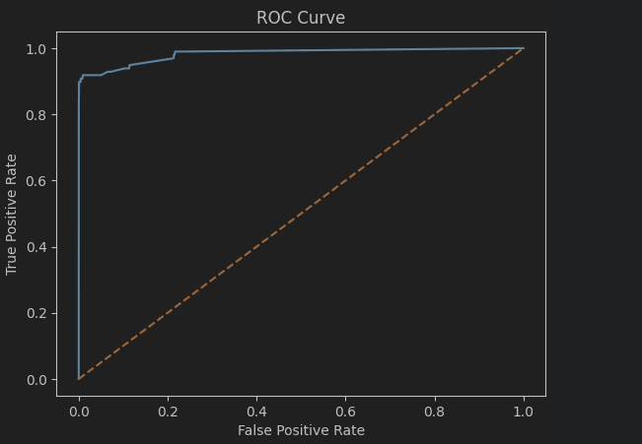

Slide 17
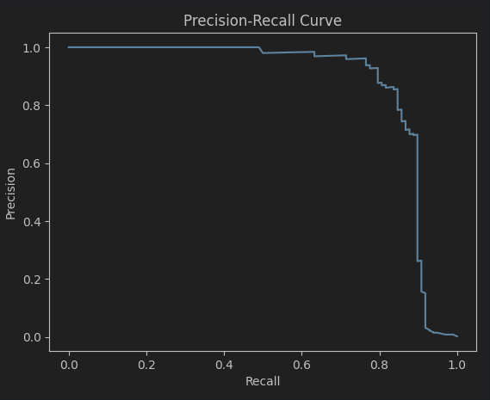

Slide 18
Limitations
Dataset is from 2013—may not reflect modern fraud patterns
PCA-transformed features → lower interpretability
SMOTE may introduce synthetic noise
Fraud patterns evolve → model must be retrained continuously

Slide 19
Future Work
Use cost-sensitive learning for real-money risk tuning
Deploy model with monitoring (MLOps)
Try Deep learning models
Add explainability tools (SHAP) for analysts
Adjust decision thresholds for business needs

Slide 20
Conclusion
Built full ML pipeline for fraud detection
Tuned Random Forest achieved strong performance
High detection rate, low false positives
Demonstrated that classical ML can be highly effective on imbalanced fraud datasets

